Slide 1
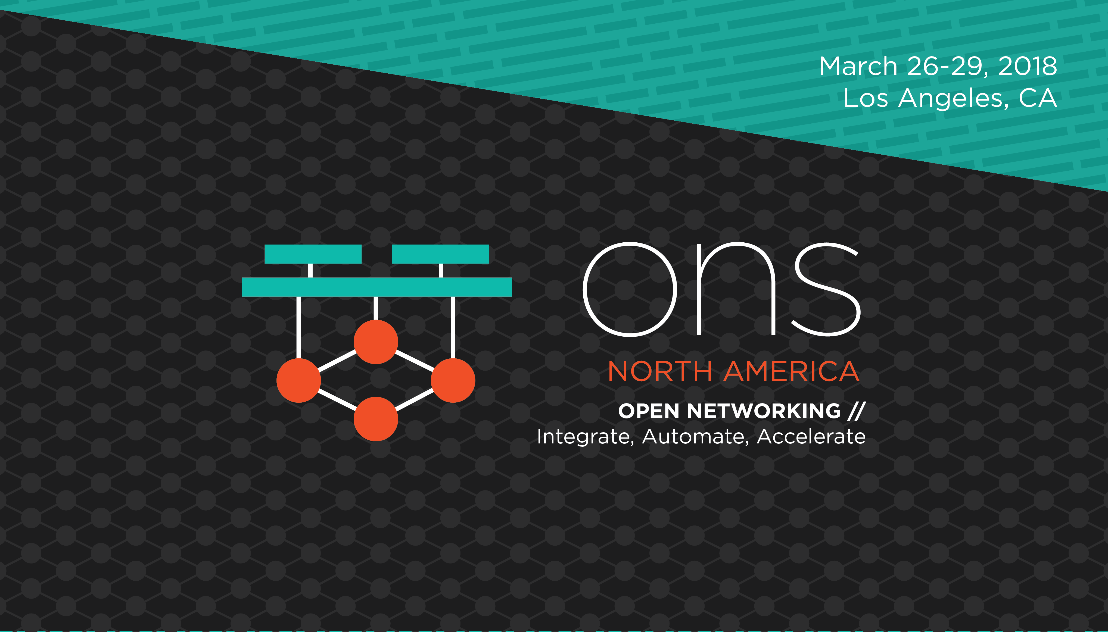

Slide 2


The Intelligent Network Infrastructure
David Meyer
Chief Scientist
dmm@1-4-5.net

Slide 3
Agenda
What can ML/AI bring to the network?
Huawei’s Approach: Intelligent Network Infrastructure
- Architecture and Impacts
- Key Technologies
- Case Studies
Roadmap

Slide 4
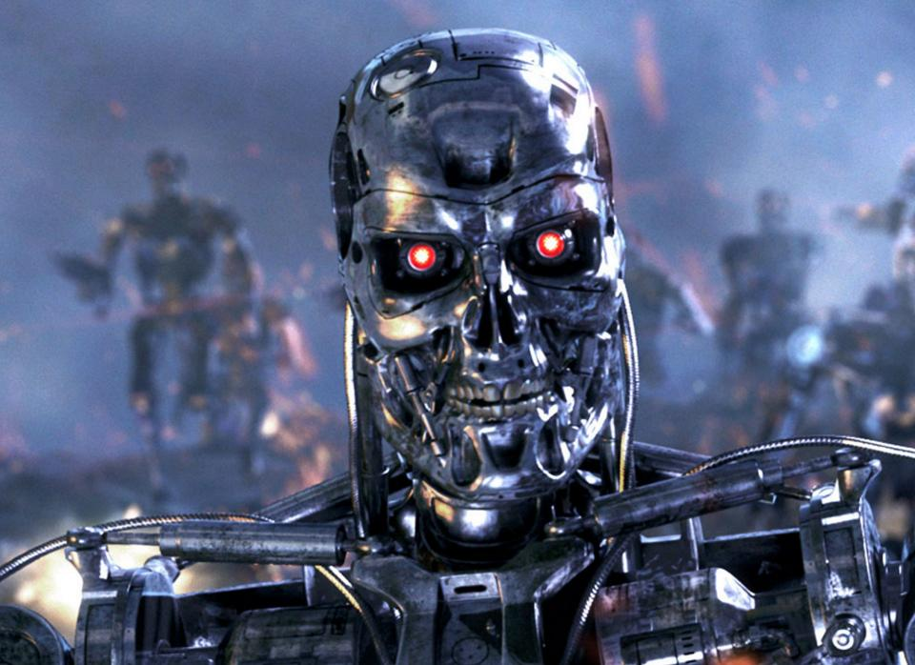
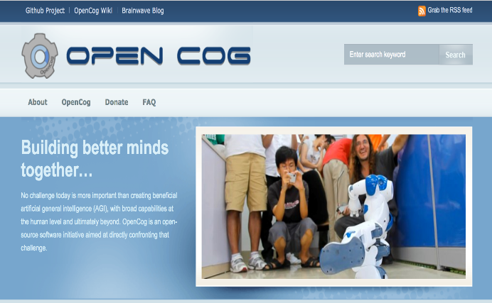
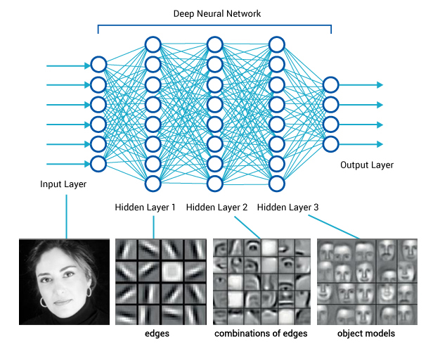
Before We Dive In
What This Talk Is Not About
Artificial General Intelligence (AGI)
Defn: An AGI is an intelligent machine that can successfully perform any intellectual task that a human being can
Sometimes: Strong AI
What This Talk Is About
Machine Learning [Focus on Networking]
Solving Engineering Problems
May be used by AGI
Sometimes: Narrow or Weak AI

Slide 5
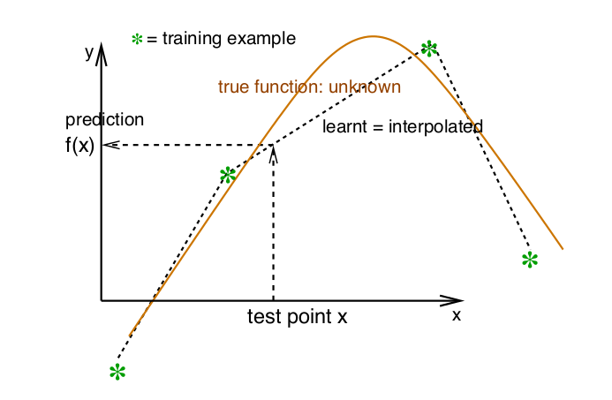
BTW, What Assumptions Are We Making?
Many
Perhaps the most basic assumption/prior: Smoothness
x close to x’ → f(x) close to f(x’)
Other Priors
Multiple explanatory factors/distributed representations
Hierarchical organization of explanatory factors
Shared factors across tasks
Manifolds
Sparsity
Simplicity of Factor Dependencies
https://arxiv.org/pdf/1206.5538.pdf

Slide 6
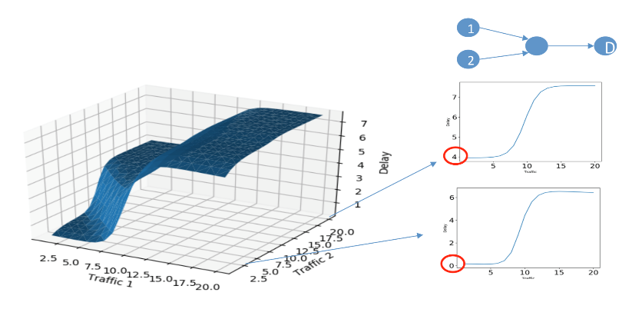
So What Can ML/AI Do For Networks?
Coarse Control
IP traffic is dynamic and bursty at any time scale (self-similarity/scale invariance)
Overprovisioning typical approach to QoS.
Automation
New and services (e.g. IoT) exceed the manual capacity.
Introducing ML/AI into network aims to improve automation (lots of runway)
Wide & Static Safety Margin
Predictions are probabilistic and networks exhibit many different stochastic behaviors.
Typical approach to deal with ”noise”: Use the average, maximum, and variance to compute a (likely suboptimal) safety margin. Example: Overprovisioning vs. QoS
Reactive
Reactive control responds to events after the event occurs.
Need proactivity since reactive might be too late.
Reactive Control
Centralized
Response Period
Emerging
Distributed
Learning (data) will play more important roles in all network functions. As such we must design s/w and h/w for data export (but what format, what meta-data, etc).
Note: Dependence (correlation) does not imply causation. How then can we accomplish many of our primary tasks (e.g. root cause analysis) in a non-ad-hoc fashion?
Local
Dead Corner
Visual field & Precision

Slide 7
ML/AI Functionality For Networks
GOOD AT | VALUE
Solving Complex Problems | Dynamic Control Dynamically control the traffic both in overlay / underlay network and flow / packet level. Real-time and fine-grain policies.
Automated Decision-Making | Lower OPEX Automated decision-making simplifies the operations.
Mining and Modeling | Enable More ML enable various forms inference which can be used to proactively guarantee the QoS and QoE.

Slide 8

Lots of work trying to bring ML to networking
Routing
“Self-Aware Networks: the Cognitive Packet Network and its Performance”
“Towards a cognitive routing engine for software defined networks”
Note: Distance vector routing vs. TD(0) learning
Traffic Engineering
“RLTE: Reinforcement Learning for Traffic-Engineering”
“Experience-driven Networking: A Deep Reinforcement Learning based Approach”
Resource Management
“Resource Management with Deep Reinforcement Learning”
Congestion Control
“TCP ex Machina: Computer-Generated Congestion Control”
“An experimental study of the learnability of congestion control”
https://www.ietf.org/proceedings/101/slides/slides-101-iccrg-pcc-performance-oriented-congestion-control-00.pdf
 | Rollout
1 | Best Effort: No traffic optimization
2 | Traditional TE: Use static policy to optimize traffic.
3 | Open Loop Control: Based on stage 2, implement traffic monitoring and recognition. Manually make the policies and adjust the network configuration in period.
4 | Closed Loop Control: Based on stage 3, some (but not all) network policies can be deployed and executed automatically and others retain human decision-making (e.g. via recommender systems)
5 | Autonomous Networking: Based on stage 4, all the network policies can be deployed and executed automatically. Again, retain open loop control

Slide 9
Agenda
What can ML/AI bring to the network?
Huawei’s Approach: Intelligent Network Infrastructure
- Architecture and Impacts
- Key Technologies
- Case Studies
Roadmap

Slide 10

Architecture
Control APPs
Model
Management
Plane
Control
Plane
Collection
Plane
Modeling
Alg
Control Alg
Eval Alg
Status
Collection
Action
Dispatch
AI
Mng
AI
Control
AI
Data Process
AI Platform
Network Status
Control actions
Training Data Set
Data Mng
Collection
Cleaning
Complement
Management
Plane
Control
Plane
Collection
Plane
A new plane: Data Collection Plane
Data measurement, collection and process
Serving three planes (Control, Management, Forwarding)
AI
Mng
AI
Control
AI
Data Process
Measurement
AI Platform
Embedded
AI
Forwarding
Plane
Training Data Set
Data Mng
Forwarding
INI Network Node

Slide 11
Impact on Control Plane
IMPACT | FROM | TO
Data-driven self-learning | human study & design | learn from data, optimize ops
High frequency operations for real-time optimization | manually adjustment in months | automatic operation in seconds (or less)
Emerging of self-shaping control protocols | human designed protocols | agents develop optimized communication protocols (Example: Google Translate’s use of NTMs, interlingua)
BTW, what is the difference between dependence (e.g. correlation) and causality, and can you learn causal relationships from non-experimental observations?

Slide 12
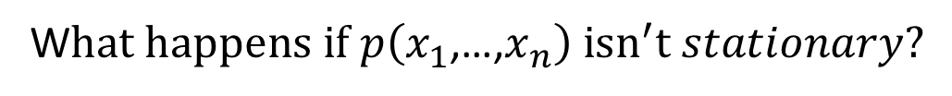
Impact on Management Plane
IMPACT | FROM | TO
Data-driven self-learning | human study & design | algorithms learn from data
Human interfaces | all the details | hide details and only provide KPIs
Information type | historical statistics, current status monitoring, tons of logs | summarized, analyzed, predicted report
When we observe some data, what are we really observing?
The joint distribution over the variables of interest, $p(x_{1}\text{,…,}x_{n})$
$p(x_{1}\text{,…,}x_{n})$is called the Data Generating Distribution (DGD)
W$hat happens if p\left(x_{1}\text{,…,}x_{n}\right){ isn}^{′}t stationary?$

Slide 13
Impact on Forwarding Plane
IMPACT | FROM | TO
Data measurement requirement | Limited data measurement | More data measurement needed
Forwarding mechanism | Forwarding mechanism matching current control system， Example: ACLs configured manually in many cases | New control system e.g. traffic balancing in forwarding procedure according to specified percentage of each next hop in routing table
ML assisted forwarding plane | Reactive/Preset resource reservation | predictive resource allocation
BTW, under what conditions can we be “predictive” (and what does predictive even mean)?

Slide 14


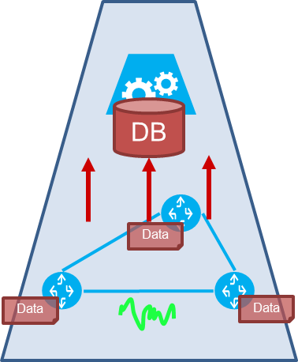
Emergence of the “Collection” Data Plane
As with the network and service complexity increases, data will play an increasingly important role
- Data collection is a complex and heavy load work. It needs careful organization and design.
- Support multi-layers
- Functions: network state measurement, centralized or distributed, planning/optimization/compression of measurement.
Large-scale
Aggregation
Data Plane
Distributed
Data
DB
Small-scale
Aggregation
Data
Data
Small-scale. Feedback and reactive when necessary.
Data
Data
Data
Large-scale. Data become an abstract of lower infrastructure and services. Become an independent and global view of network
Middle-scale. Data become a set of network states. Support the local controller functions

Slide 15
Agenda
What can ML/AI bring to the network?
Huawei’s Approach: Intelligent Network Infrastructure
- Architecture and Impacts
- Key Technologies
- Case Studies
Roadmap

Slide 16
Modern ML: Theory + Engineering
Theory
Reinforcement learning to learn control (actions). Contrast inference (regression, classification, …)
Stochastic modeling & variational inference: Variational AutoEncoders，Bayesian Networks
Hierarchical/multi-layer Control
Self-shaping protocols
Temporal prediction (RNNs such as LSTM, etc)
Engineering
Open loop control (e.g. recommender system), digital twins, threshold limitation, online-learning …
Rapid learning: limit the impact of the learning phase (for example, low-shot learning)
Scalability
Forwarding plane ML
Efficient data collection: Selective data measurement, telemetry
What is the ”effective distance” between theory and practice in ML these days?

Slide 17
Agenda
What can ML/AI bring to the network?
Huawei’s Approach: Intelligent Network Infrastructure
- Architecture and Impacts
- Key Technologies
- Case Studies
Roadmap

Slide 18



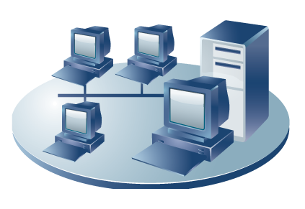


Case Study 1: Intelligent Traffic Balancing
Learning
Inference
Ctrl Loops
AI + TE
____Goal
Congestion avoidance.
Real-time load balancing.
Improving QoS
Data
Data
collector
AI
controller
Controller
____Solution
Multi-path route computation by traditional graph algorithms, for each Ingress-Egress pair.
Online Reinforcement Learning algorithm adjusts traffic distribution at every router to multiple outgoing ports. What would a reward function look like?
Modified forwarding plane forwards packet according to the percentage in flowlets to keep packet order
CORE
____Benefit
Reducing Max-Link-Utilization by 23% (vs ECMP)
Reducing data loss by 64% (vs ECMP)
Reducing link delay by 19% (vs ECMP)
Achieves performance close to both MLU and packet loss with CONGA (ms-level distributed control) using second-level centralized control.
Automatically adapts to evolving traffic pattern and network status
AGG
ACC
MAN (Metro Area Network)

Slide 19




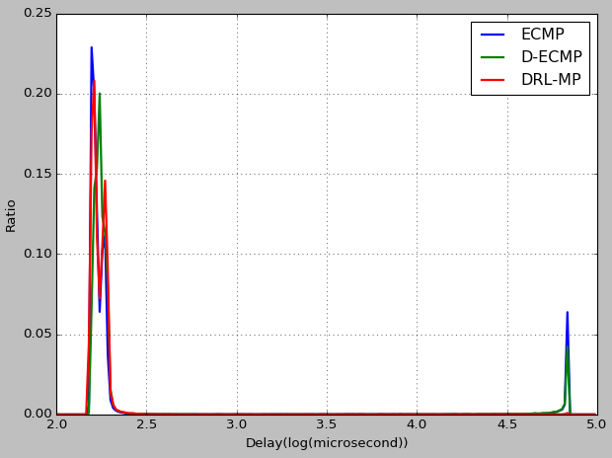
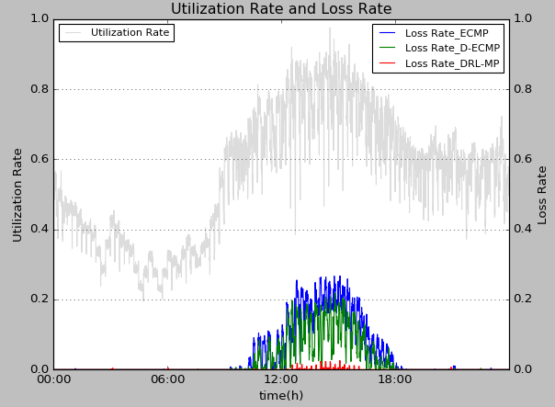
Case Study 2: Intelligent Overlay Routing
AI + SD-WAN
Learning
Inference
Ctrl Loops
Data
End-to-End Quality
Controller
Traffic Rerouting
Probe
____Problem
Underlying networks are black-boxes
WAN path quality keeps changing, only partially predictable
Optimal leased-line/VPN traffic routing is based on estimated path quality
ISP networks are black-boxes to users.
Routes, link status are changing and unknown.
Only end-to-end quality is measureable.
____Solution
Online Reinforcement Learning algorithm provides adaptive routing from dynamic path quality
Multiple objective: Delay, jitter, dropping, cost
Probability Distribution
of Delay
Traffic
____Benefit
30% average delay improvement over test bed (vs D-ECMP)
Automatically adapts to evolving status of underlying networks
~0.2ms
~50ms
Packet Loss
Delay

Slide 20

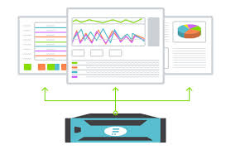
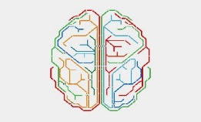


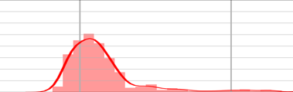

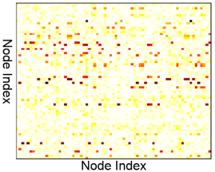

Case Study 3: QoS Inference Engine
Learning
Inference
Ctr Loops
AI + Modeling
Data
Controller
Precise Network Capacity Planning
Real-time QoS Monitoring & Anomaly Detection
Smarter AI design
with QoS prediction
Reliable AI control for SLA guarantee
Applications
Supports customizable QoS models (e.g., delay, jitter and loss); Enable real-time SLA guarantees throughout the network, including quasi-real time QoS monitoring and anomaly detection. What is anomaly detection and how might you do it?
Human
(Open Loop)
AI Controller
(Close Loop)
Network QoS (delay,jitter, loss…)
Infer QoS distribution
Achieve millisecond-level QoS response based on generative ML algorithms
QoS Inference Engine
LSTM:
Traffic feature extraction
VAE:
QoS distribution reconstruction
Inference
Self-learning directly from historical traffic; Achieve automatic inference of full probability distribution as opposed to point estimates.
Collect traffic matrix
along time

Slide 21
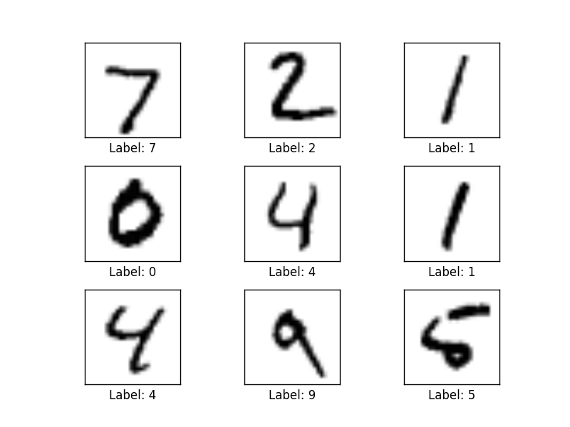
Aside: What is an Autoencoder?
To understand what an autoencoder is, we need a data set
Why MNIST? I thought we were talking about networks… Well, I’m using MNIST here because you can easily visualize what is going on. In our case, instead of the input being vectors of {0,1} we will have vectors of counters of various features s/a bandwidth, and other network and host based metrics/KPIs.
MNIST: 28x28 Grayscale Handwritten Digit Dataset
Training set: 55000 images
Test set: 10000 images
Validation set: 5000 images
Features here are pixels (28x28 = 784)

Slide 22
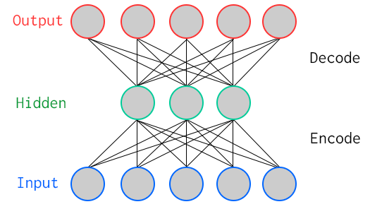
Autoencoder? Special Kind of Neural Network
784
100
784
Key Characteristic: Hidden layer has fewer units than input/output → Compression
Goal: Minimize reconstruction (decode) error
How to define error (loss, cost)?
Binary classification: Threshold reconstruction error → normal/abnormal
Unsupervised learning

Slide 23
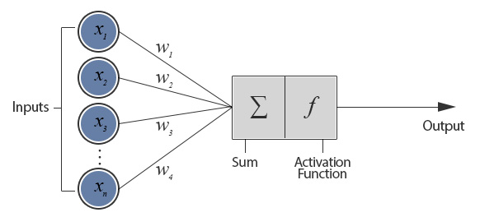
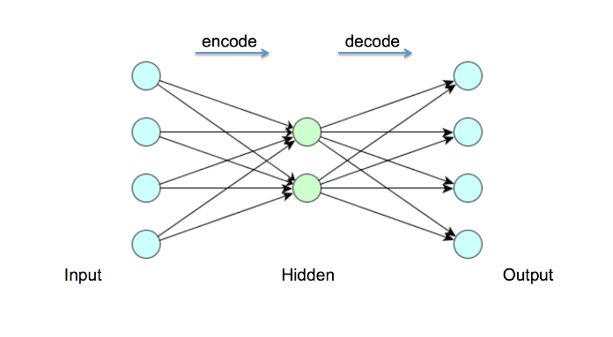
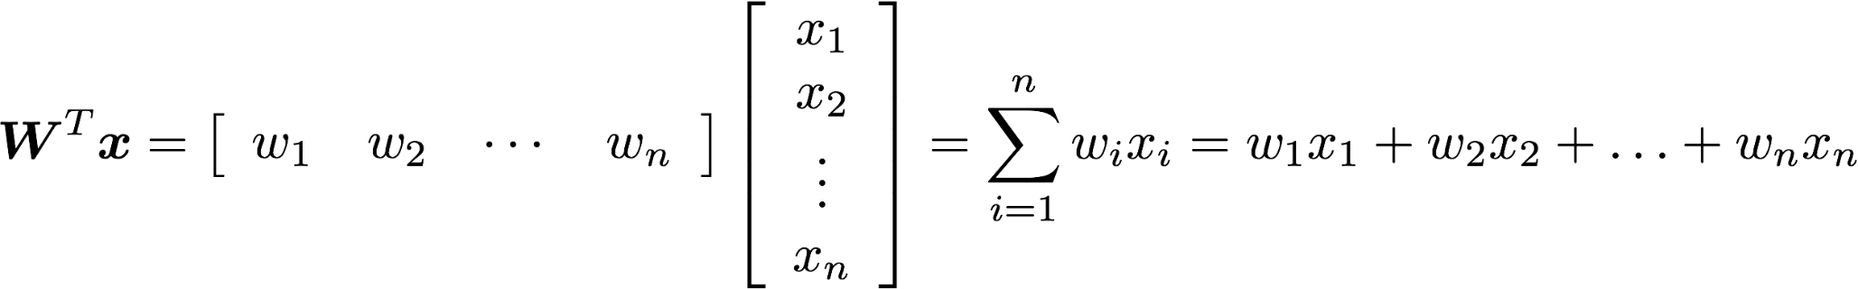
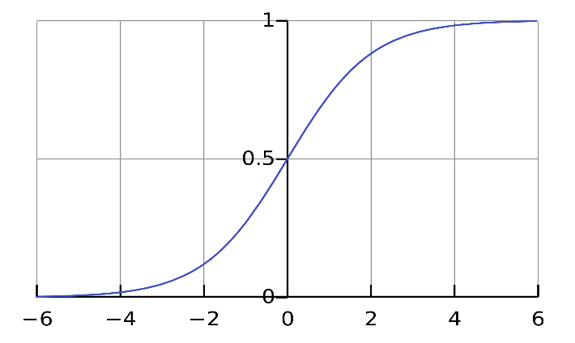
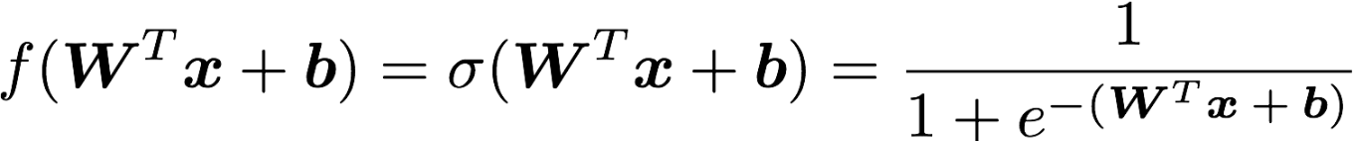
But First: What Does A Single Neuron Do?
Inner (dot) Product
784
100
784
How many parameters?
784x100 + 100x784 = 156800
Sigmoid/logistic Function

Slide 24
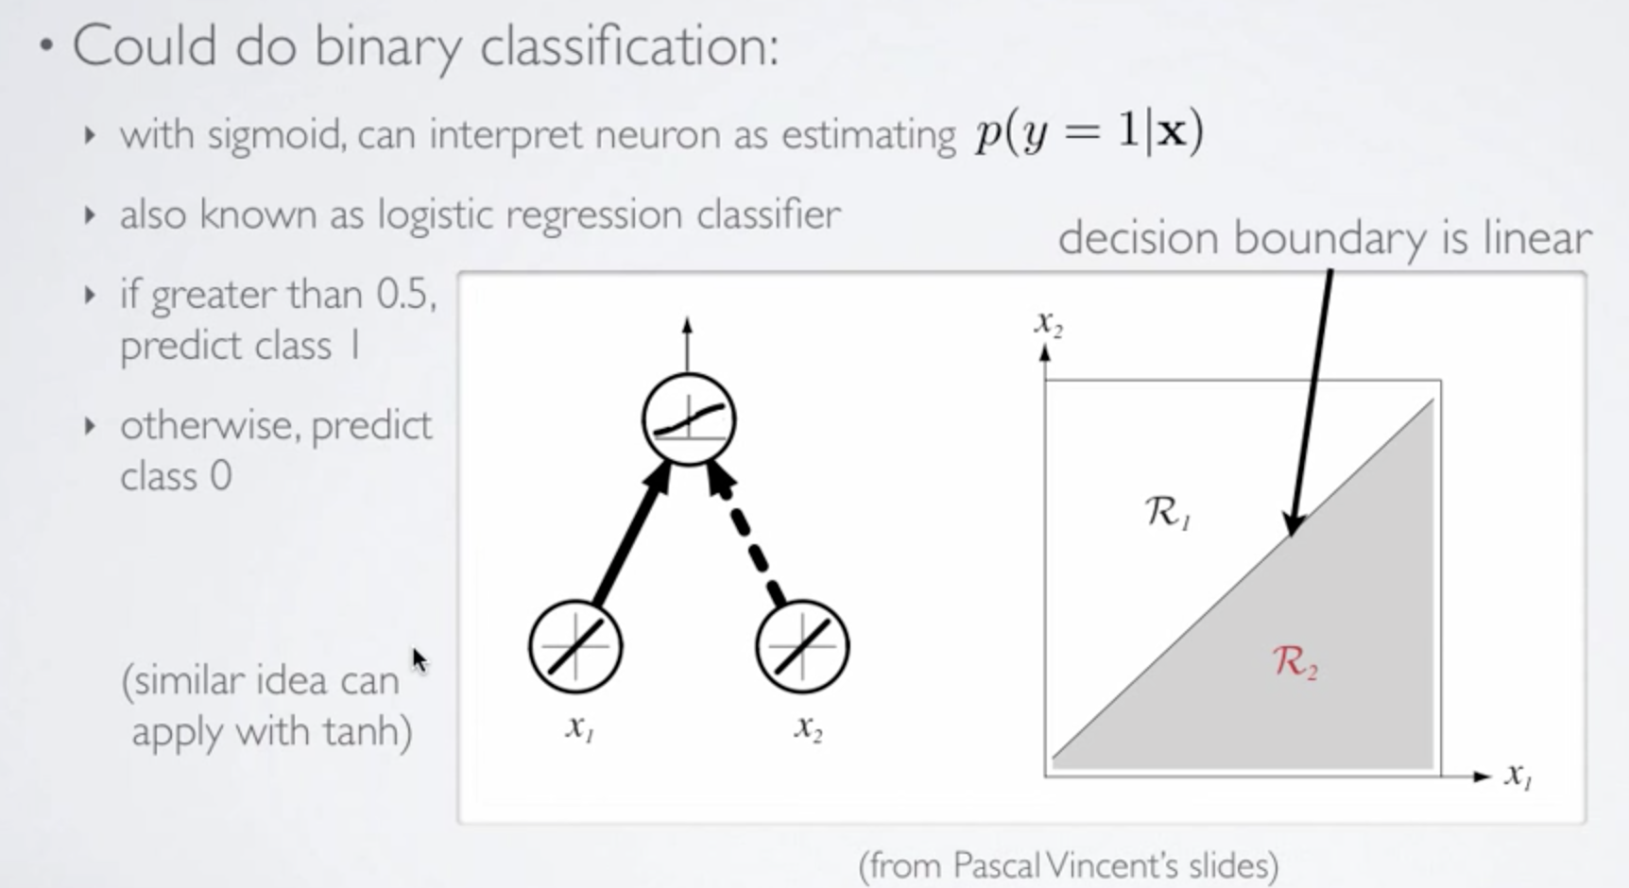
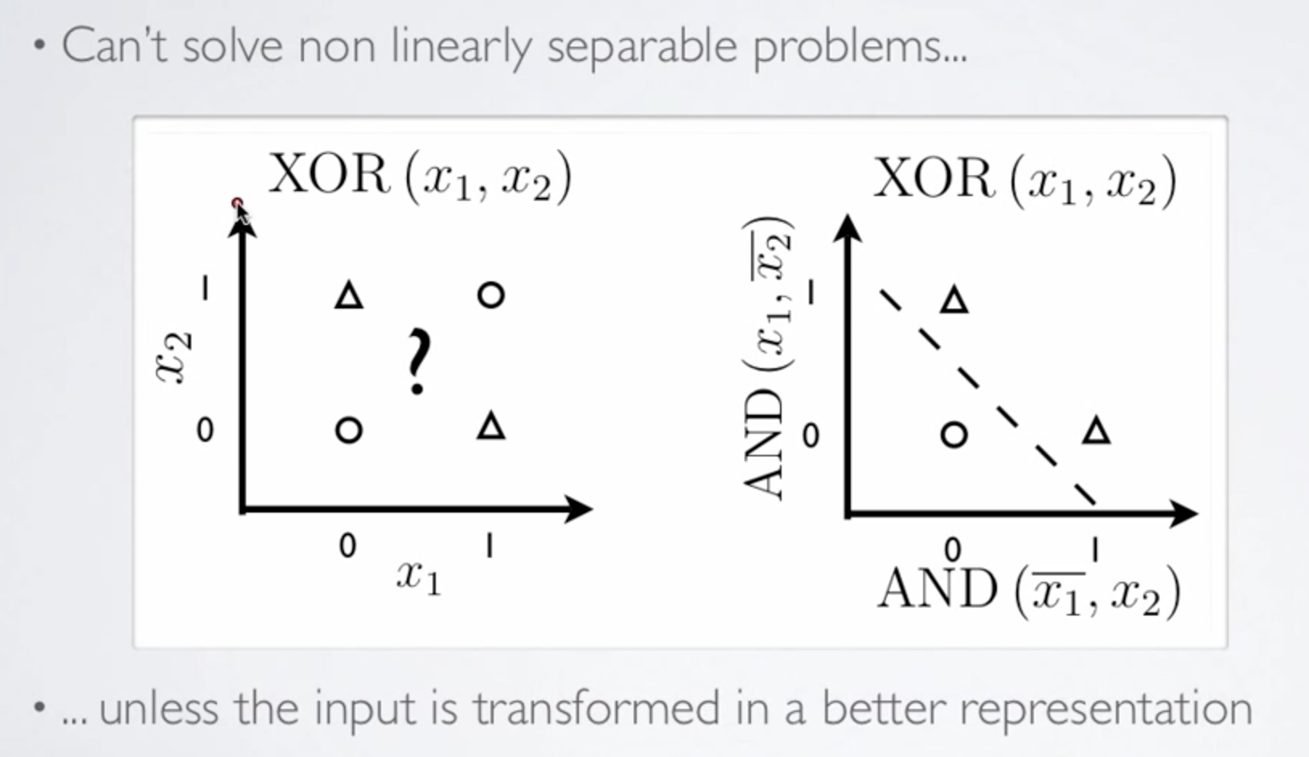
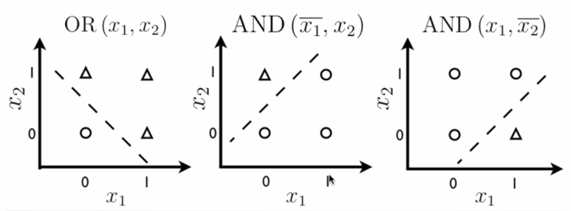
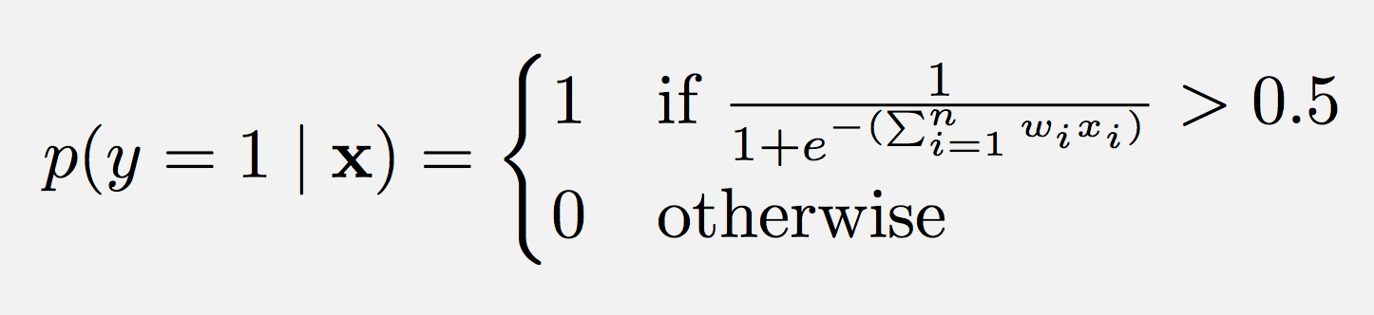
So What Kinds of Things Can a Single Artificial Neuron Compute?
Can Solve Linearly Separable Problems
Graphic courtesy Hugo Larochelle

Slide 25
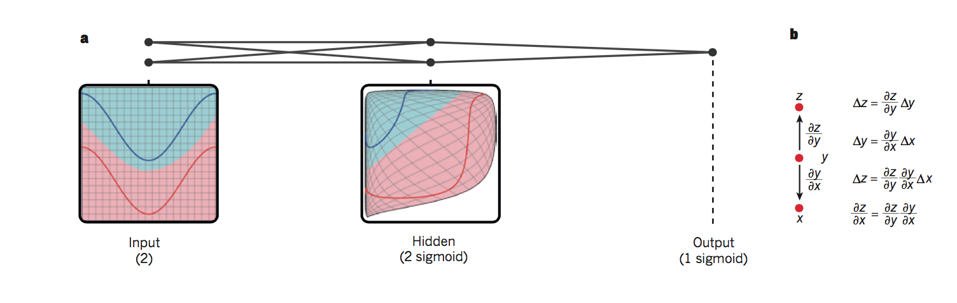

So What is Really Happening Here?
Linear Decision Boundary
Target function represented by input data is some twisted up manifold
Deep Nets disentangle the underlying explanatory factors in the data so as to make them linearly separable
Graphic courtesy Christopher Olah
Voronoi diagram under Euclidian distance
Voronoi diagram under Euclidian distance
Linear Separability in a Neural Network
Linear Separability in a Neural Network

Slide 26
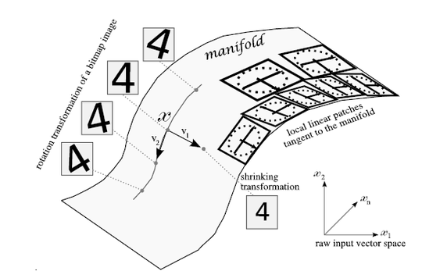
Manifolds?
X is a high dimensional vector (MNIST: 28² = 784)
Data concentrated around a lower dimensional manifold
Hope is to find representation of that manifold
Graphic courtesy http://www.deeplearningbook.org

Slide 27
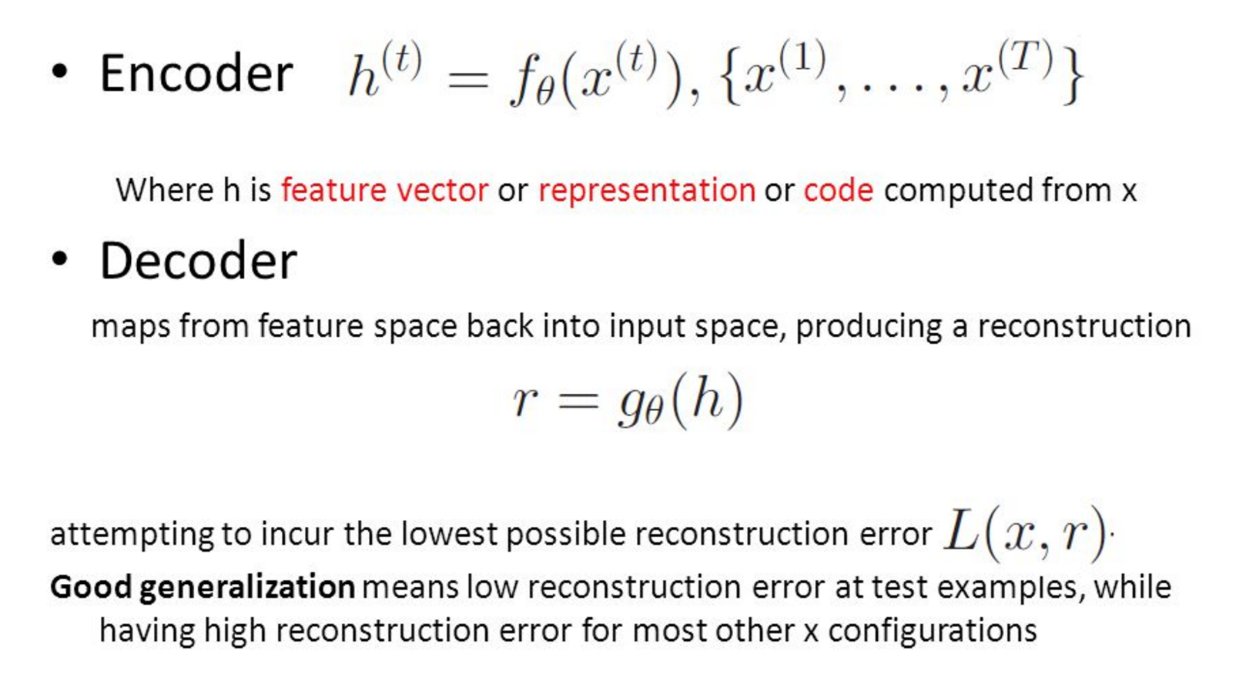
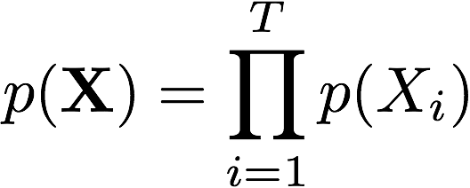
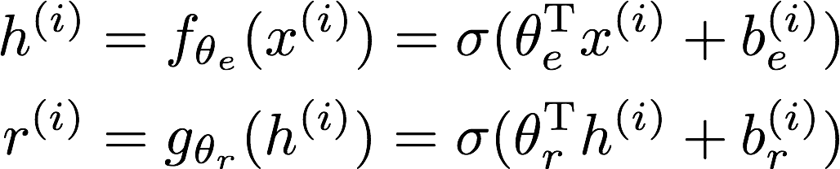
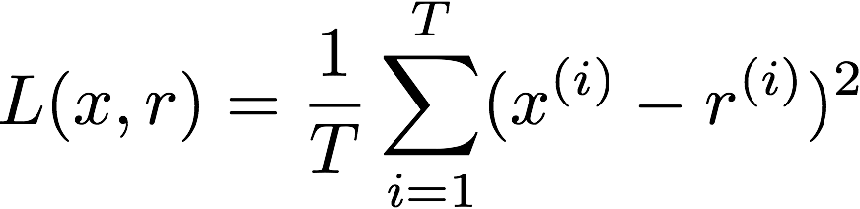
So OK, All Cool, But How Does The Autoencoder Actually Work?
But First: What do we need to assume?
Learning comes down to adjusting the weights (w_{i}’s) so that the loss L(x,r) is minimized. This is the job of backpropagation (calculate the gradients) and gradient descent (find the minima of the loss function).
Independent Identically Distributed (iid) data
What does this mean? The joint distribution factorizes.
Suppose we have T samples. Then iid →

Slide 28
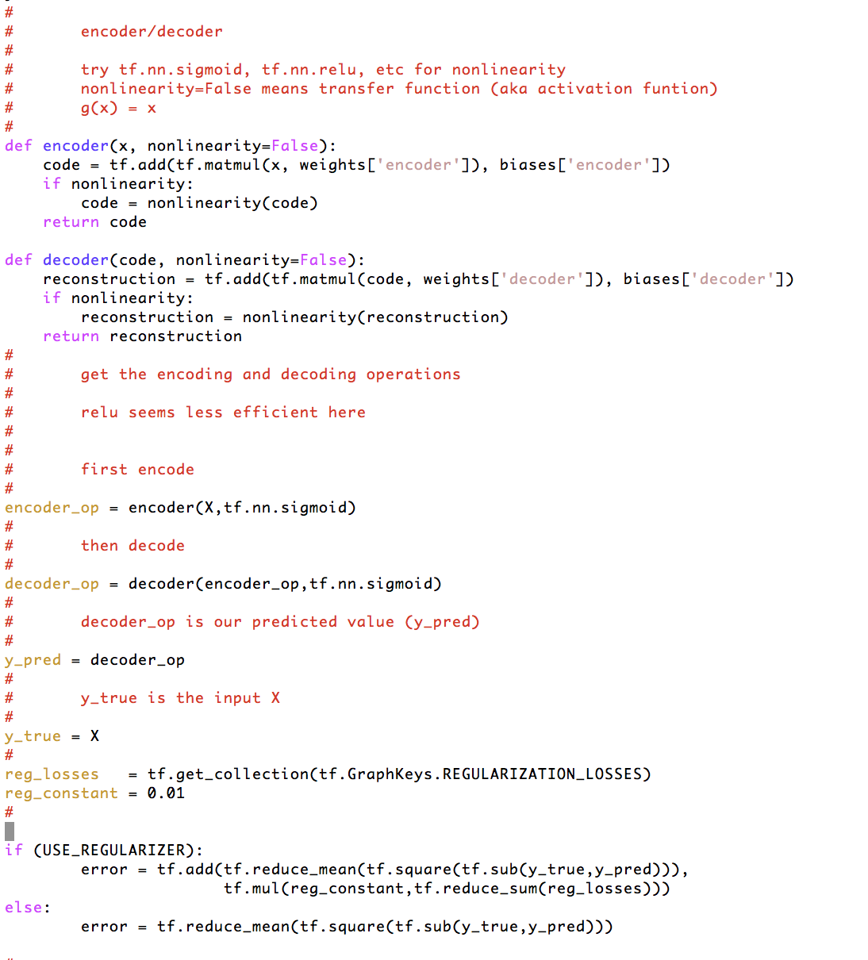

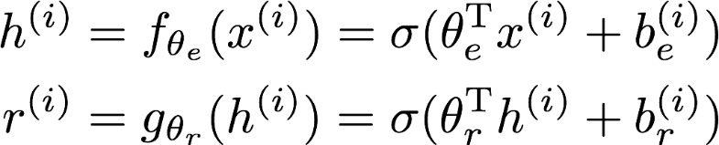
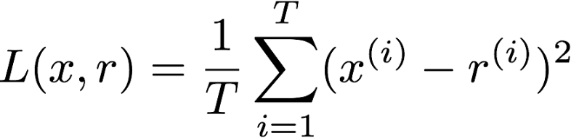
How Hard To Code This Up In Tensorflow?
https://github.com/davidmeyer/ml/blob/master/tensorflow/autoencoder.{py,ipynb}

Slide 29
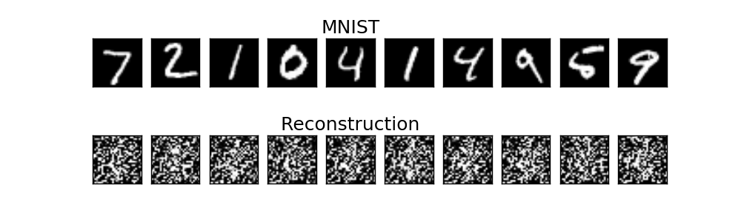
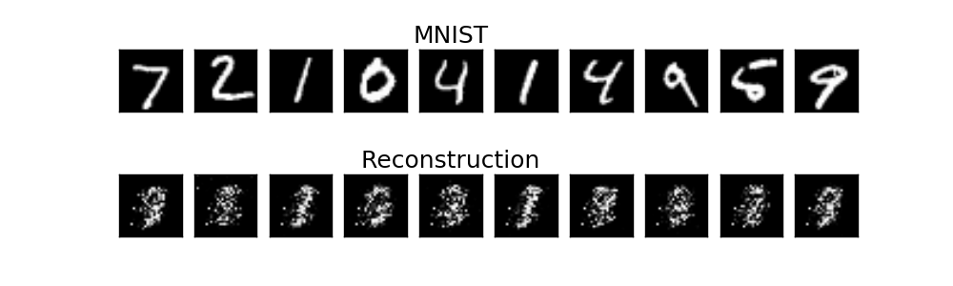
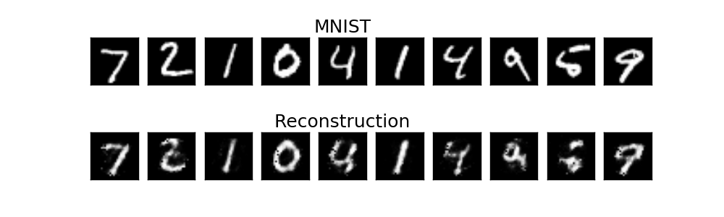
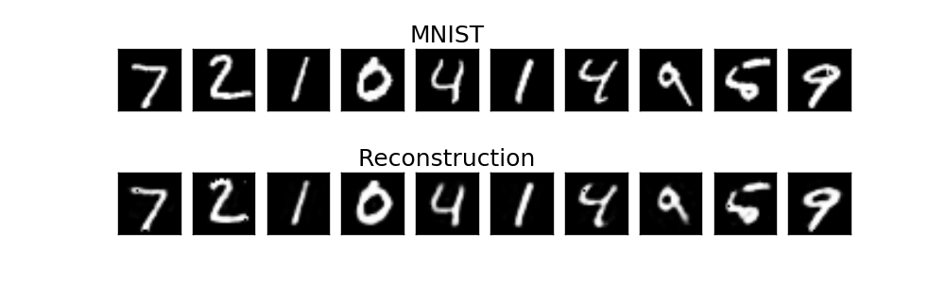
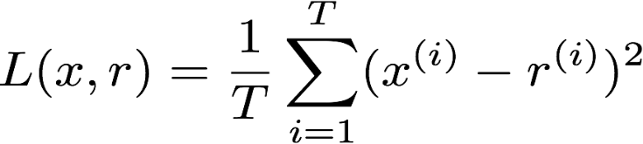
Autoencoder Output
1 example
10 examples
100 examples
1000 examples
After training, the AE gets low reconstruction error on digits from MNIST and high reconstruction error on everything else: It has learned to recognize MNIST

Slide 30
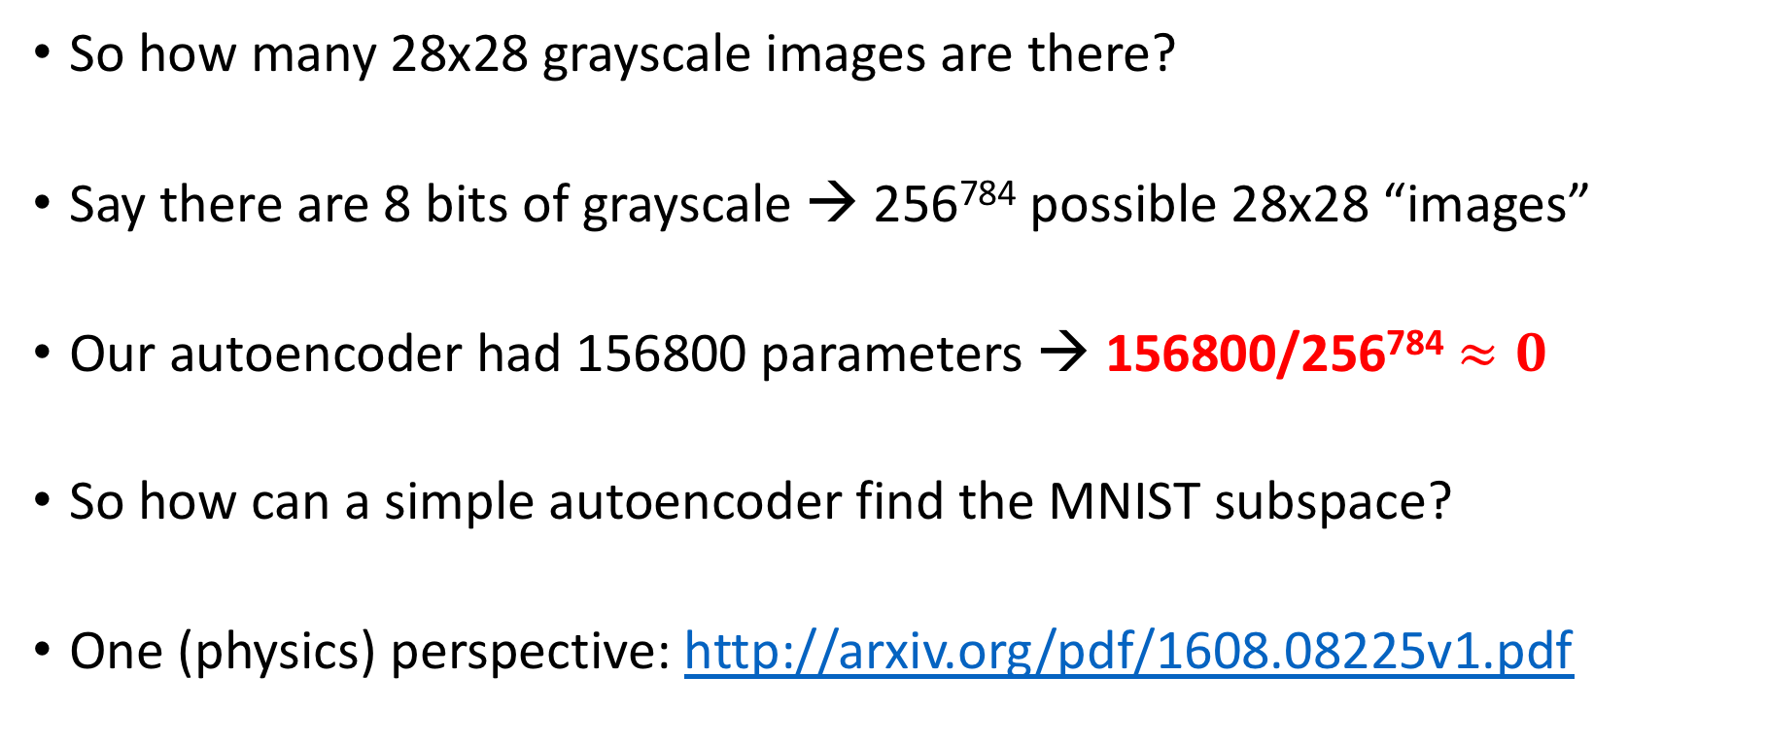
Aside: How Big is the MNIST Space?
So how many 28x28 grayscale images are there?
Say there are 8 bits of grayscale → 256⁷⁸⁴ possible 28x28 “images”
Our autoencoder had 156800 parameters → 156800/256⁷⁸⁴ $≈0$
So how can a simple autoencoder find the MNIST subspace?
One (physics) perspective: http://arxiv.org/pdf/1608.08225v1.pdf

Slide 31

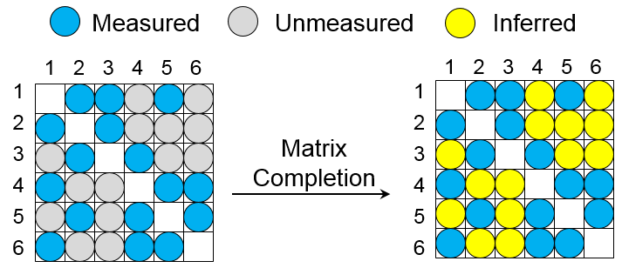
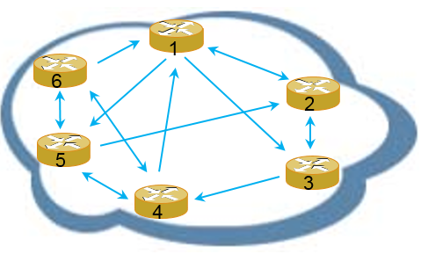
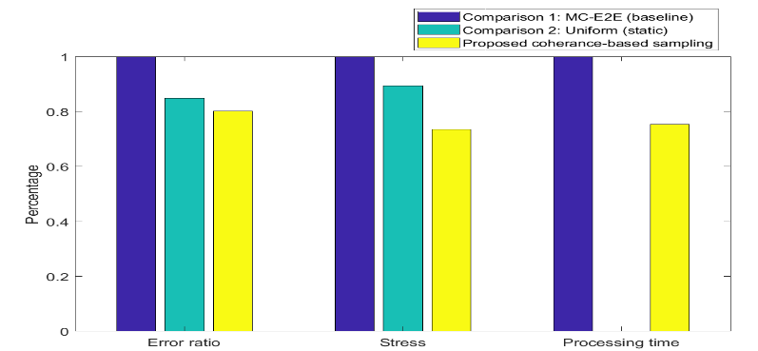
Case Study 4: Intelligent Measurement
Learning
Inference
Ctrl Loops
AI + Measurement
AI App & Others
Data
Controller
Data-driven
Addresses the data requirement for ML applications
Visualization network performance
Scale
Intelligent measurement
Data recovery via matrix completion by measuring only 20% of node-pairs
Online schedule of measurement points based on matrix coherence feature
Selective measurement & recovery by Coherence-Based Sampling
Network
20%
27%
25%
Performance improvement on latency measurement (Note that comparison 2 of uniform sampling is static with no online scheduling).

Slide 32
Agenda
What can ML/AI bring to the network?
Huawei’s Approach: Intelligent Network Infrastructure
- Architecture and Impacts
- Key Technologies
- Case Studies
Roadmap

Slide 33
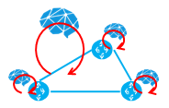
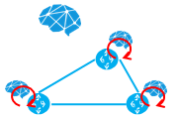
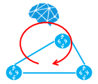
Roadmap
Global optimized
Policy assistant
Admin assistant
Causal analysis
Separate ML/AI applications
e.g. Temporal prediction
Management
Plane
Integrated hierarchical control
Centralized control +
Isolated distributed control
Centralized control
Separate ML/AI applications
Global optimized collection & inference
Intelligent prefetching
Control
Plane
Selective collection & completed by inference
Data cleaning
Measurement Collection
Service optimization @ wire speed
Collection
Plane
Separate optimized operations
e.g. predictive resource management
Additional forwarding options
Probing
Advanced
Forwarding
Plane
Intermediate
Entry

Slide 34

DEMO: #44 HUAWEI
Intelligent Network Infrastructure —— HUAWEI’s Practice on Network + AI Technologies
PROVIDE
- Automation & Adaptation
Automates and simplifies operations of network management in background of evolving traffic pattern and network construction.
Learning
Inference
Ctrl Loops
Intelligence
- Best Status At Every Second
Optimizes traffic over networks in real-time, to be well balanced, congestion-free for optimal QoS.
Data & Control
Data
Collecter
SDN
Controller
- Optimal and guaranteed QoS
Proactively avoid the congestion, failure and potential problems so that to guarantee the QoS for customer’s services.
Device

Slide 35
Q & A
Thanks!

